Slide 1
Regression

Slide 2
Agenda for Today’s Session
WHAT IS REGRESSION
We will understand the Regression and will move onto the types.
UNDERSTANDING LOGISTIC REGRESSION
Lets Look into the Algorithm & understand how it functions.
REGRESSION DIAGNOSTICS
Lets find what best works with Linear Regression
INTERVIEW QUESTIONS
Covering some interview questions to strengthen the knowledge and give an idea about Interviews too.
UNDERSTANDING LINEAR REGRESSION ALGORITHM ASSUMPTIONS
Lets Look into the Assumptions & Violations
LINEAR REGRESSION vs LOGISITIC
Lets find out the difference between Linear & Logistic Regression.

Slide 3
Lets Dive In

Slide 4
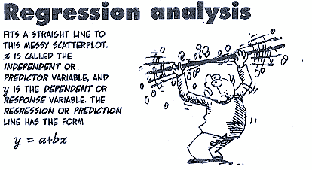
What is Regression

Slide 5
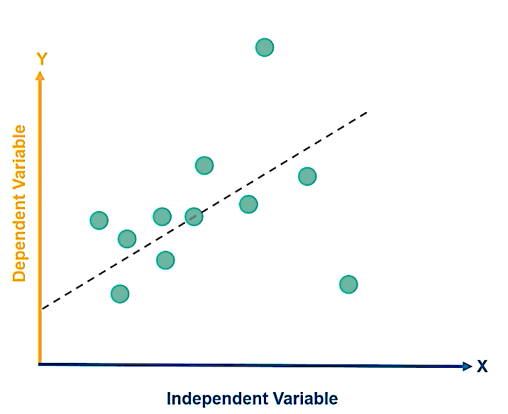
Understanding Linear Regression Algorithm
Intro
Establishes a relationship between the Independent & Dependent Variables.
Examples of Independent & Dependent Variables:-
x is Rainfall and y is Crop Yield
x is Advertising Expense and y is Sales
x is sales of goods and y is GDP
Here x is Independent Variable & Y is Dependent Variable
How it Works
Regression analysis is used to understand which among the Independent Variables are related to Dependent Variables.
It attempts to model relationship between two variables by fitting a line called Linear Regression Line.
The case of Single variable is called Simple Linear Regression where as the case of Multiple Independent Variables, it is called Multiple Linear Regression

Slide 6
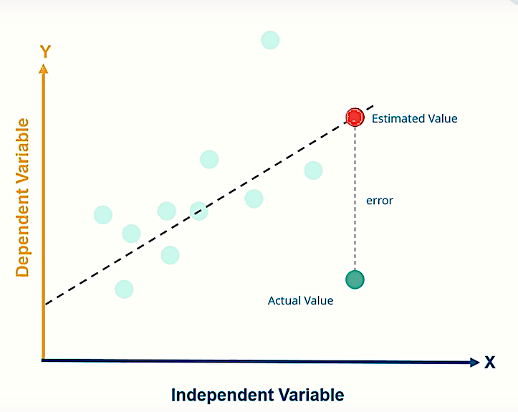
Single Linear Regression Vs Multiple Linear Regression
The Linear Regression line is created using Ordinary Least Square Method.
Simple Linear Regression
X
Y
Multiple Linear Regression
X₁
Multiple
Predictors
X₂
Y
X₃
X₄

Slide 7
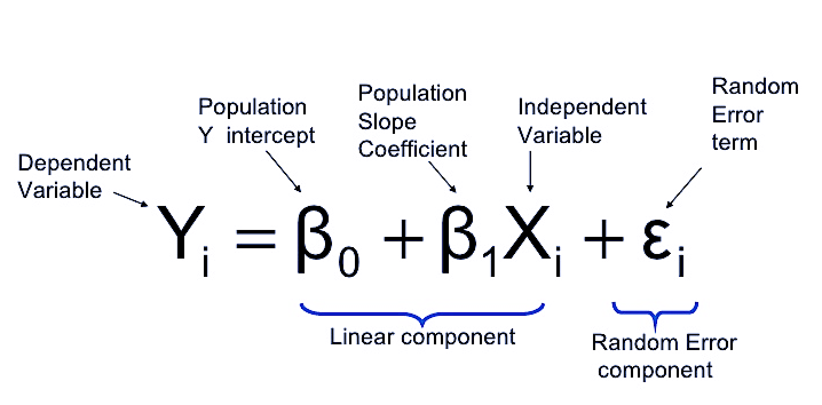
Linear Regression Equation
Slope/Gradient
y = mx + c
Y Intercept

Slide 8
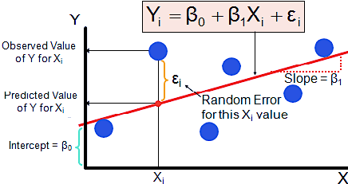
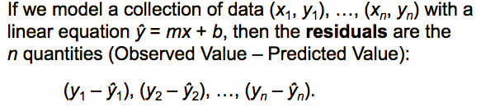
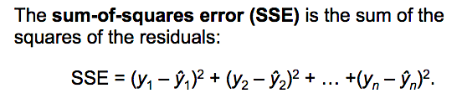
Sum of Squared Error
What is Error?
Actual Value – Predicted Value is called Error
Here Predicted Value is the value predicted by the Linear Regression Model.
Also known as Residual.
Why it is Important?
Smaller the residuals, more accurate model it would be.

Slide 9
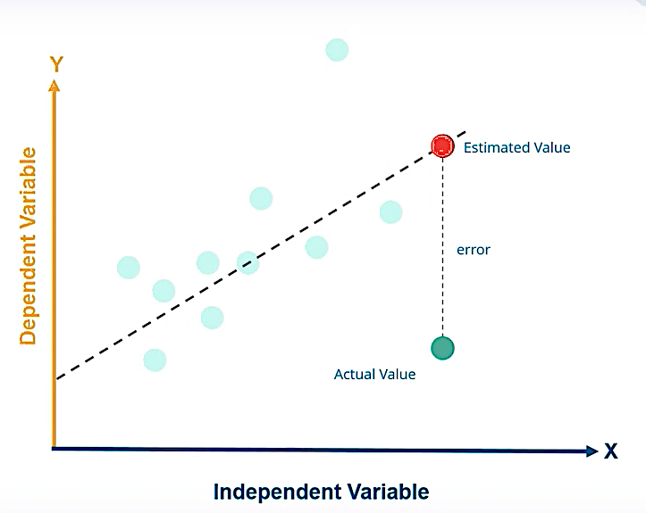
Regression Line | Best Fit Line
What is the Line of Best Fit?
The Best Fit Line is the line that gives the minimum SSE.
Amongst all the possible lines, there will be one line that will be the best fit meaning greatest possible accuracy as a model.
The line that minimizes the sum of squared error of residuals is called Regression Line or the Best Fit Line.
In Simple Terms, it represents a straight line that best represents the data on scatterplot. It is drawn using the Least Square Method.
Use the Least Square Method to Determine the Eqn. of Line of Best Fit
x | 8 | 2 | 11 | 6 | 5 | 4 | 12 | 9 | 6 | 1
y | 3 | 10 | 3 | 6 | 8 | 12 | 1 | 4 | 9 | 14

Slide 10
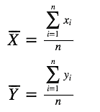
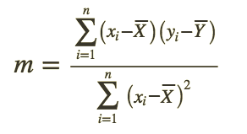
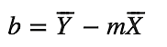
Finding Best Fit Line Algorithm
How to find the Best Fit Line?
The equation of the straight line is given by y = mx +c
m – slope of the line
c - Intercept (The point at which the straight line touches y axis.
The Best Fit line is found basis the Least Squared Method.
Algorithm:
Step1: Find the Mean of x-values and y-values
Step2: Calculate the slope of the line. It can be found using the following eqn. on the right.
Step3: Compute the y-intercept of the line using the formula
Mean of x and y values
Finding m (Slope)

Slide 11
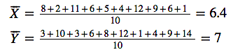
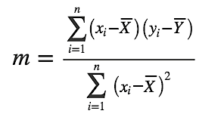
Regression Line | Best Fit Line
Use the Least Square Method to Determine the Eqn. of Line of Best Fit
Steps: Following Steps are deployed to achieve the objective.
Step1: Calculate the Mean of X and Ys
Step2: Find the Following:-

Slide 12
Regression Line | Best Fit Line
Step1: Calculate the Mean of X and Ys
The mean value of x is 6.4 and y is 7
Step2: Find the m (slope)
m (slope) = -131/118.4 = -1.1 approx.
Step3: Calculate the y intercept
b (intercept) = 7 – (-1.1) * 6.4 = 14.0 approx.
Thus, the equation of the line is y = -1.1x + 14

Slide 13
Regression Equation and Line of Best Fit

Slide 14
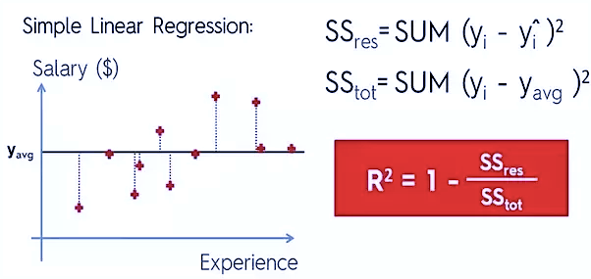
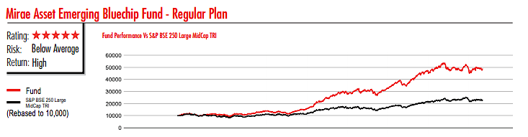
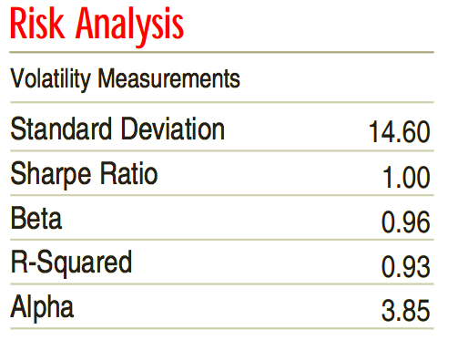
R Squared
R Squared is a statistical measure that represents the proportion of the variance for a DV explained by IV.
While correlation defines the strength, R Squared explains up to what extent the variance of one variable explains the variance of another var.
Example – In Investing, the R Squared is %age of a fund movement that can be explained by the movement of benchmark(sensex)
Aka Coefficient of Determination.

Slide 15
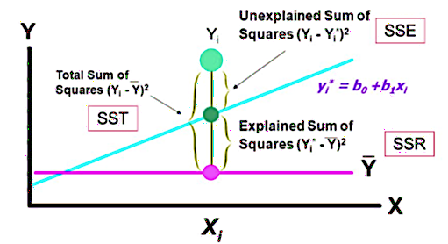
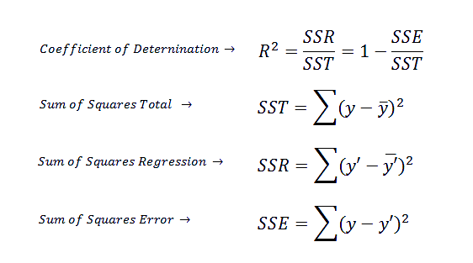
Coefficient of Determination

Slide 16
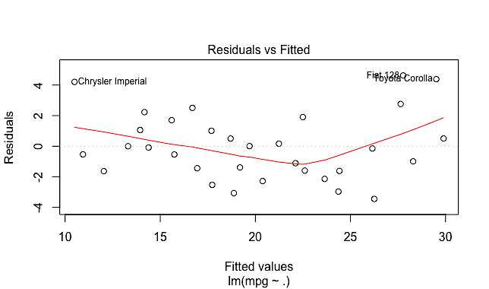
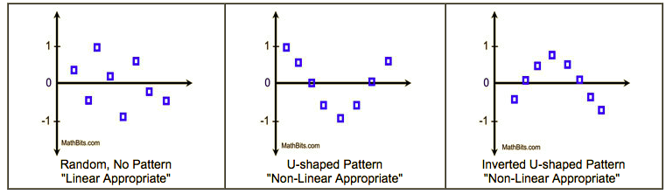
How to see if the Assumptions are Violated – Deciding if Linear Model is a good Fit
Residual vs Fitted Values Plot
The x-axis has the fitted values and y axis has the Residuals.
Residual = Observed y value – Predicted y value.
Vertical distance of actual point vs line of the best fit is called Residual.
If unsure about the shape (curve) for regression equation by looking into the scatterplot, a residual plot helps in making decision.
Data should be randomly
scattered around line 0
When a pattern is observed in a residual plot, a linear regression model is probably not appropriate for your data.

Slide 17
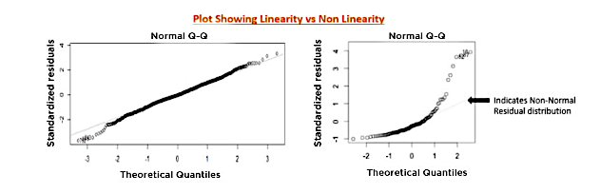
Normal Q-Q Plot (Quantile Quantile Plot)
If the data is normally distributed, the points in the QQ-normal plot lie on a straight diagonal line.
Greater the departure from this reference line, the greater the evidence that the data is not following the normal distribution pattern.

Slide 18
Interview Questions
01. Which of the following is true about Residuals?
Lower is Better
Higher is Better
A or B depends on the situation.
None of these

Slide 19
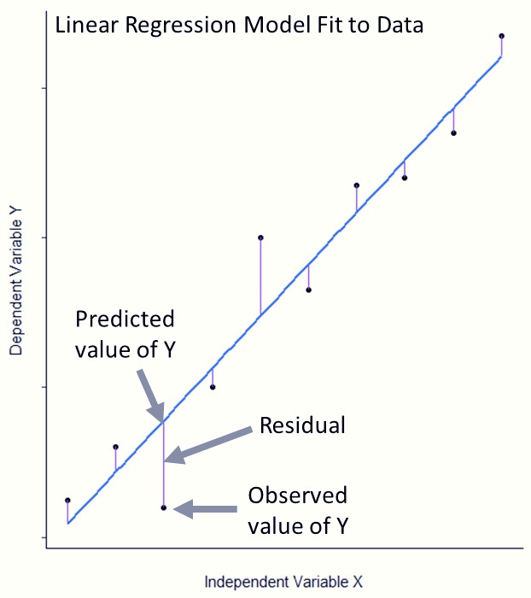
Interview Questions - Solution
01. Which of the following is true about Residuals?
Lower is Better
Higher is Better
A or B depends on the situation.
None of these
Solution A: Residuals refer to the error value of the model. Hence, Lower is Better. ( Residual = y – yhat)

Slide 20
Interview Questions
02. Which of the statement is true regarding residuals in regression
Mean of the Residuals is always zero.
Mean of the Residuals is always less than zero.
Mean of the Residuals is always more than zero.
There is no such rule for residuals.

Slide 21
Interview Questions - Solution
02. Which of the statement is true regarding residuals in regression
Mean of the Residuals is always zero.
Mean of the Residuals is always less than zero.
Mean of the Residuals is always more than zero.
There is no such rule for residuals.
Solution: A
Sum of residual in regression is always zero. It the sum of residuals is zero, the ‘Mean’ will also be zero.

Slide 22
Interview Questions
03. To Test linear relationship of y (dependent) and x (independent) continuous variable, which of the following plots are best suited.
Scatterplot
Barplot
Histograms
None of These.

Slide 23
Interview Questions - Solution
03. To Test linear relationship of y (dependent) and x (independent) continuous variable, which of the following plots are best suited.
Scatterplot
Barplot
Histograms
None of These.
Solution: A
To test the linear relationship between continuous variables Scatter plot is a good option. We can find out how one variable is changing w.r.t. another variable. A scatter plot displays the relationship between two quantitative variables.

Slide 24
Interview Questions
04. A Correlation between the age and health of a person found to be -1.09. On the basis of this you would tell the doctors that:
The age is good predictor of health
The age is poor predictor of health
None of These.

Slide 25
Interview Questions - Solution
04. A Correlation between the age and health of a person found to be -1.09. On the basis of this you would tell the doctors that:
The age is good predictor of health
The age is poor predictor of health
None of These.
Solution: C
Correlation coefficient range is between [-1 ,1]. So -1.09 is not possible.

Slide 26
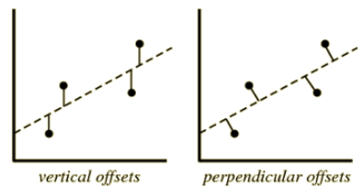
Interview Questions
05. Which of the following offsets, do we use in case of least square line fit?
Suppose horizontal axis is independent variable and vertical axis is dependent variable.
Vertical Offset
Perpendicular Offset
Both
None of the Above.

Slide 27
Interview Questions - Solution
05. Which of the following offsets, do we use in case of least square line fit?
Suppose horizontal axis is independent variable and vertical axis is dependent variable.
Vertical Offset
Perpendicular Offset
Both
None of the Above.
Solution: A
We always consider residual as vertical offsets. Perpendicular offset are useful in case of PCA.

Slide 28
Linear Regression – Model Assumptions
Since Linear Regression assesses whether one or more predictor variables explain the dependent
Variable and hence it has 05 assumptions:
Linear Relationship
Normality
No or Little Multicollinearity
No Auto Correlation in errors
Homoscedasticity
Note on sample size – The sample size thumb rule is that regression analysis requires at least 20 data points per independent variable in analysis.

Slide 29
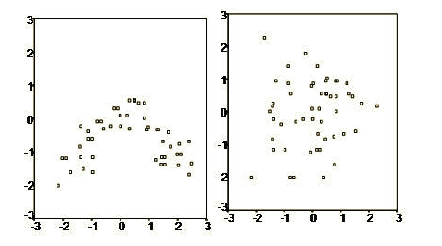
1. Check for Linearity
Linear Regression needs the relationship between the independent & dependent variable to linear & additive.
Being additive means the effect of x on y is independent of other variables.
The linearity can be checked using the scatter plots.
Some examples are shown on right. It shows little to no correlation

Slide 30
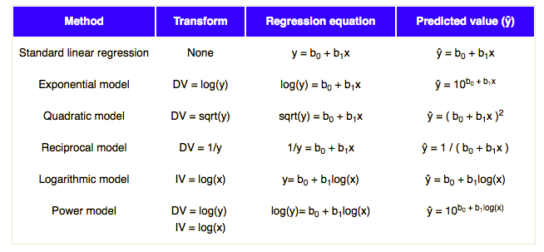
Transforming Variables to Achieve Linearity
Each Row shows a different transformation method.
Transform column shows the method of transformation to be applied on DV or IV.
Regression equation is the equation used in analysis.
Last Column shows the equation of Prediction.

Slide 31
Non Linear to Linear Conversion
Steps Involved:-
Create Linear Regression Model.
Construct a residual plot
If the plot is random, don’t transform the data.
Compute the Coefficient of Determination (R2)
Choose a Transformation method as mentioned in table in previous slide.
Transform IV or DV or both.
Apply Regression
If the Transformed R2 is greater than the previous score, the transformation is a success.
The best transformation depends of the data & the best model will give the highest
coefficient of Determination.

Slide 32
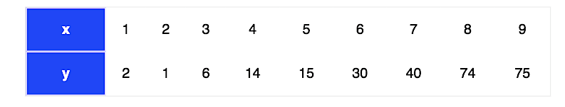
Transformation Example
Objectives:
Create Linear Regression Model in Excel or R.
Find the Linear Regression Equation
Make Predictions
Create a Residual Plot and Find if Linear Regression is an Absolute Fit or not.
If Not, Try Transformation

Slide 33
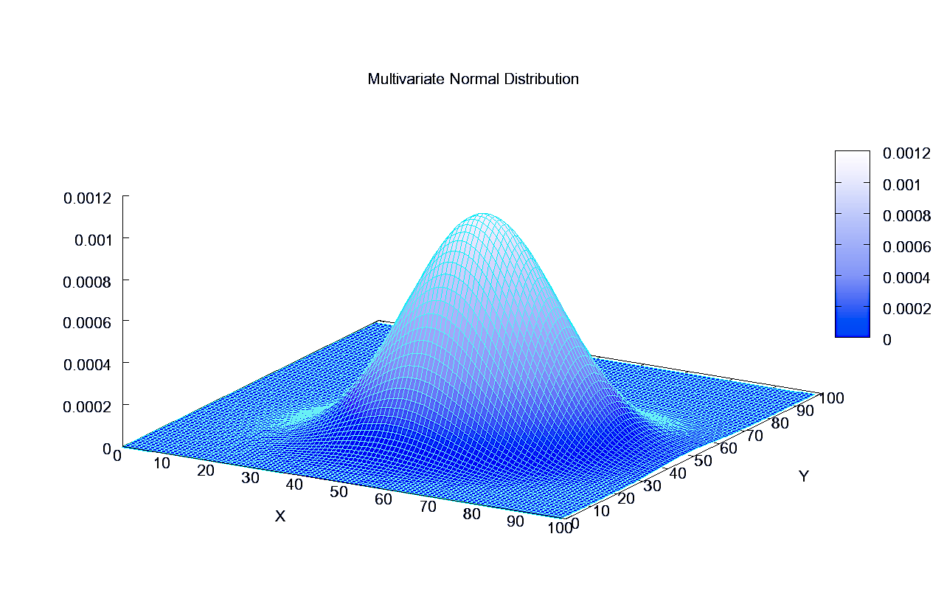
2. Check for Normality
Linear Regression requires all the variables need to be normal.
The normality can be checked using the histogram or Q-Q Plots.
Test for Normality aka goodness of fit test is called Kolmogorov Smirnov Test or Shapiro Wilk Normality Test
If the Data is not normal a non linear transformation ( e.g. Log Transformation) can fix the issue.
Normality means that Y values are normally distributed to each X.

Slide 34
3. Check for Multicollinearity
It means that the predictors are correlated with each other. Presence of correlation in independent variables lead of Multicollinearity.
What happens if variables are correlated - it becomes difficult for the model to determine the true effect of Independent Variables on Dependent.
Measure of Multicollinearity is given by VIF (Variable Influence Factor)
VIF tells us if the predictors are correlated, how much variance of an estimated coefficient increases. If no factors are correlated, VIF will be 1.
If VIF is 1 - No Multicollinearity.
VIF>1, the predictors may be correlated.
VIF between 5 & 10 – Indicates high correlation.
VIF >10: Regression coefficients are poorly estimated due to Multicollinearity.
Solution:
To drop the variable showing high Collinearity. The presence of C suggests that the information provided by this variable for the DV is redundant and is of no use.
Another Approach is to combined the collinear variables and create new predictor (for e.g. taking average).

Slide 35
Plots Showing Heteroscedasticity

Slide 36
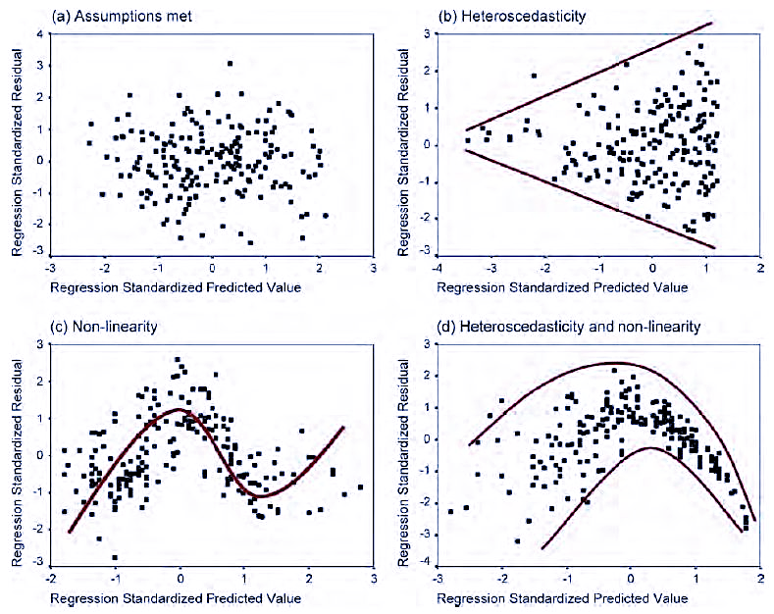

Slide 37
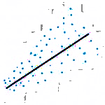
4. Heteroscedasticity
Meaning that Data has different dispersion. In other terms, it is called with unequal scatter.
Why it is a Problem
It is a problem because OLS Regression assumes that all residuals are drawn from population that has constant variance ( Homoscedasticity). Ruins Results. Gives Biased Coefficients.
Heteroscedasticity, also spelled heteroskedasticity, occurs more often in datasets that have a large range between the largest and smallest observed values.
A classic example of heteroscedasticity is If you model household consumption based on income, you’ll find that the variability in consumption increases as income increases.
Breusch-Pagan / Cook Weisberg Test - This test is used to determine presence of heteroskedasticity. If you find p < 0.05, you reject the null hypothesis and infer that heteroskedasticity is present.
Image Source: Google

Slide 38
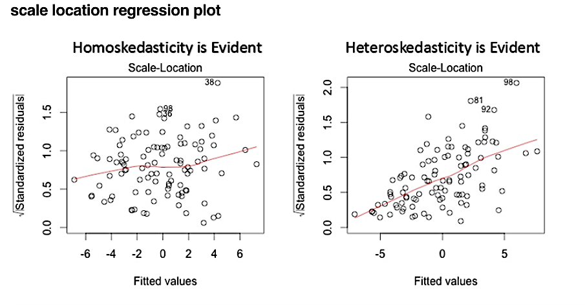
Scale Location Plot
This plot is also useful to determine heteroskedasticity. Ideally, this plot shouldn't show any pattern.
Presence of a pattern determine heteroskedasticity.
Don't forget to corroborate the findings of this plot with the funnel shape in residual vs. fitted values.

Slide 39
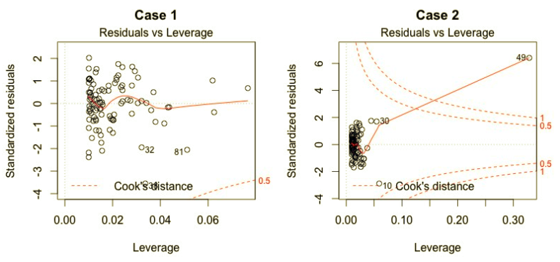
Leverage Plot
Leverage: An observation with an extreme value on a predictor variable is called a point with high leverage. Leverage is a measure of how far an observation deviates from the mean of that variable. These leverage points can have an effect on the estimate of regression coefficients.

Slide 40
Summary of Tests in Python for Linear Regression Assumptions
Multicollinearity Test
from statsmodels.stats.outliers_influence
import variance_inflation_factor
Variance Inflation Factor
Normality Test
from scipy.stats import shapiro
Shapiro Wilk Test
Jarque Bera Test
Autocorrelation Test
Durbin Watson Test
Breusch Pagan Test
Heteroscedasticity Test
import statsmodels.stats.api as sts
Goldfeld Quandt Test
Breusch Pagan Test
Non Linearity Test
import statsmodels.stats.api as sts
Linear Rainbow Test

Slide 41
Auto Correlation of Residuals
Auto Correlation of Errors means that the errors are Correlated.
Assumption is that the Linear Regression Model Residuals are Not Correlated.
Test of Assumption – Durbin Watson Test
Package - statsmodels.stats.stattools.durbin_watson(resids, axis=0)
What is the Null Hypothesis
The Null Hypothesis of the test is that there is no serial correlation.
Statistics (Always between 0 and 4)
The test statistic is equal to 2*(1-r) where r is the sample autocorrelation of the residuals.
Thus for r==0 indicating no serial correlation, the test statistic equals 2.
Closer to 0, more evidence for positive serial correlation and closer to 4 indicates negative serial correlation.

Slide 42
Assessing Goodness of Fit - R²
After fitting the model, it becomes essential to understand how well the model fits the data.
When the Model Fits Best on the Data?
A Model fits the data well if the difference between the actual value and the model’s predicted value is small and unbiased.
What is R-Squared (R²)?
It is a statistical measure of how close the data is to the fitted regression line. The definition of R-squared is fairly straight-forward; it is the percentage of the response variable variation that is explained by a linear model. Or:
R-squared = Explained variation / Total variation
R-squared is always between 0 and 100%:
0% indicates that the model explains none of the variability of the response data around its mean.
100% indicates that the model explains all the variability of the response data around its mean.
In general, the higher the R-squared, the better the model fits your data.

Slide 43
Interview Questions
01. True-False: Linear Regression is a supervised machine learning algorithm.
TRUE
FALSE

Slide 44
Interview Questions - Solution
True-False: Linear Regression is a supervised machine learning algorithm.
TRUE
FALSE
Solution A: Yes, Linear regression is a supervised learning algorithm because it uses true labels for training. Supervised learning algorithm should have input variable (x) and an output variable (Y) for each example.

Slide 45
Interview Questions
02. Which of the following methods do we use to find the best fit line for data in Linear Regression?
Least Square Method
Maximum Likelihood
Both A and B

Slide 46
Interview Questions - Solution
02. Which of the following methods do we use to find the best fit line for data in Linear Regression?
Least Square Method
Maximum Likelihood
Both A and B
Solution - A: In Linear Regression, we use the Least Square Method to identify the Best Fit Line.

Slide 47
Interview Questions
03. Which of the following evaluation metrics can be used to evaluate a model while modelling a continuous output variable?
AUC - ROC
Accuracy
Mean Squared Error

Slide 48
Interview Questions - Solution
03. Which of the following evaluation metrics can be used to evaluate a model while modelling a continuous output variable?
AUC - ROC
Accuracy
Mean Squared Error
Solution - Since Linear Regression gives the output as continuous values and hence we use Mean Squared Error metric to evaluate the model performance. Rest of the options are used in case of classification problem.

Slide 49
Interview Questions
05. Which of the following statements is true about outliers in Linear Regression
Linear Regression is sensitive to outliers
Linear Regression is not sensitive to outliers
No Idea.
None of these

Slide 50
Interview Questions
05. Which of the following statements is true about outliers in Linear Regression
Linear Regression is sensitive to outliers
Linear Regression is not sensitive to outliers
No Idea.
None of these
Solution A: The slope of regression line will change if outliers are present in the data. Therefore, it is sensitive to the Outliers.

Slide 51
Linear Regression Example
Objectives:
Create Linear Regression Model in Excel or R.
Find the Linear Regression Equation
Make Predictions
Create a Residual Plot and Find if Linear Regression is an Absolute Fit or not

Slide 52
Assessing Model Fit
Residuals
The distance of the point (Actual Line) with the Line (Line of Prediction)
Root Mean Squared Error (RMSE)
“Residual Standard Error” in Linear Model Output. It is interpreted as how far on an average, the residuals are from zero.
Mean Absolute Error(MAE)
Mean Absolute Error is another metric to evaluate the model. For example actual y is 10 and predictive y is 30. the resultant MAE would be (30-10) = 20. MAE is very robust against the effect of Outliers.
R Square
This metric explains the percentage of variance in the model. It ranges between 0 and 1. A higher value is always appreciated.
Adjusted R Square
Since R Square increases as the new data is introduced (variables) regardless of the fact that new variable is actually adding new information to the model. To overcome this, we look upto Adj. R Square which is steady and only inc or dec if the newly added variable is truly useful.

Slide 53
Difference Between Linear and Logistic Regression
Linear Regression | Logistic Regression
The Data is Modelled using a Straight Line | A statistical model that predicts the probability of an outcome that can have two values
The Outcome (Dependent Variable) is continuous in Nature | The Outcome (Dependent Variable) has only limited no of possible values
Output Variable is continuous | Output Variable is Discrete
Used to Solve Regression Problems | Used to solve the classification problems (Binary Classification)
Estimate the Dependent Variable when there is a change in Independent Variable | Calculates Probability of Occurrence of an Event
Linear regression uses ordinary least squares method to minimise the errors and arrive at a best possible fit | Logistic Regression uses maximum likelihood method to arrive at the solution
Uses a Straight Line | Uses a S Curve or Sigmoid Function
Example - Predicting Sales, House Prices, GDP etc | Predicting if email is Spam or not, credit card transaction is fraud or not or customer will buy the product or not

Slide 54
Logistics Regression

Slide 55
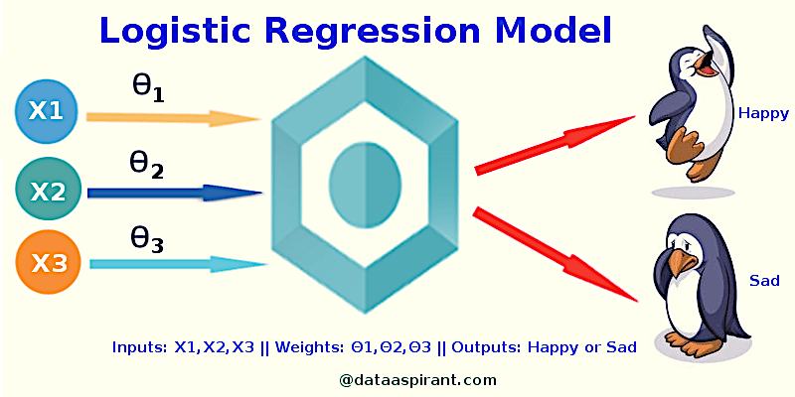
Logistics Regression
Logistics Regression is used when the dependent variable is categorical.
The values are strictly in the range of 0 and 1.
It is used to describe data and to explain the relationship between one dependent binary variable and one or more nominal, ordinal, interval or ratio- level independent variables.

Slide 56
Logistics Regression Equation
Fundamental equation of generalized linear model:
g(E(y)) = α + βx1 + γx2
Here g() is the link function. The role of link function is to ‘link’ the expectation of y to linear predictor.
E(y) is the expectation of target variable
α + βx1 + γx2 – linear predictors. (α,β,γ to be predicted).
Lets take a simple linear regression equation with dependent variable enclosed in a link function:
g(y) = βo + β(Age)
Here g() function is trying to establish probability of success (p) or probability of failure(1-p)
Criteria for p
It must always be positive (p>=0)
It must always be less than equal to 1 (p<=1)
Since probability must always be positive, we’ll put the linear equation in exponential form.
For any value of slope and dependent variable, exponent of this equation will never be negative.
p = exp(βo + β(Age))

Slide 57
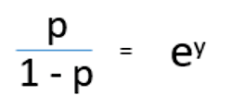
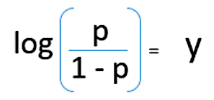
Logistics Regression Equation
p = exp(βo + β(Age))
In order to make the probability less than 1, we must divide p by a number greater than p.
p = exp(βo + β(Age)) / exp(βo + β(Age))+1
Since g(y) = βo + β(Age) and p = exp(βo + β(Age)), this gives a new equation called
p = e^y / 1+ e^y
This is the Logit Function.
The probability of success is given by p = e^y / 1+ e^y and probability of failure is given by
q = 1-p or q = 1 - e^y / 1+ e^y
On dividing both the equations, we get the following:
Or

Slide 58
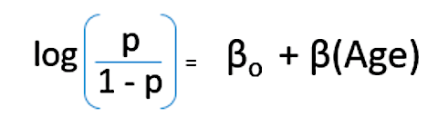
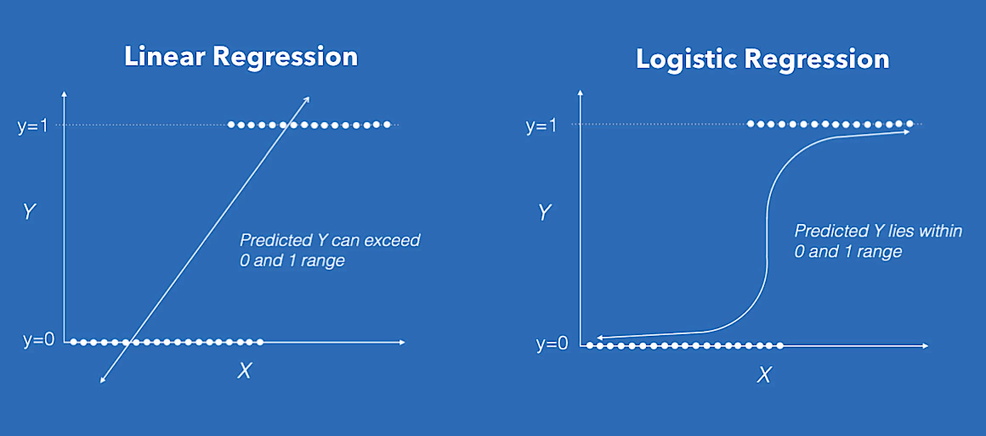
Logistics Regression equation
Final Equation
Log(p/1-p) is the link function and (p/1-p) is the odd ratio. If the log of odd ratio is found positive,
The probability of success is always more than 50%.

Slide 59
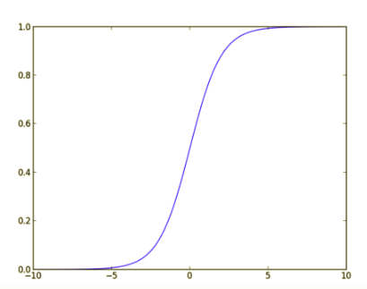
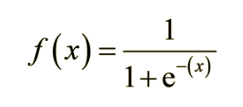
Sigmoid Function
The Sigmoid Function also called Logistics Function gives S shape that can take any real value and map into a value between 0 and 1.
The range of the values is between 0 and 1.
If the output of the sigmoid function is more than 0.5, we classify the outcome as 1 or Yes.
If the output of the sigmoid function is less than 0.5, we classify the outcome as 0 or No.

Slide 60
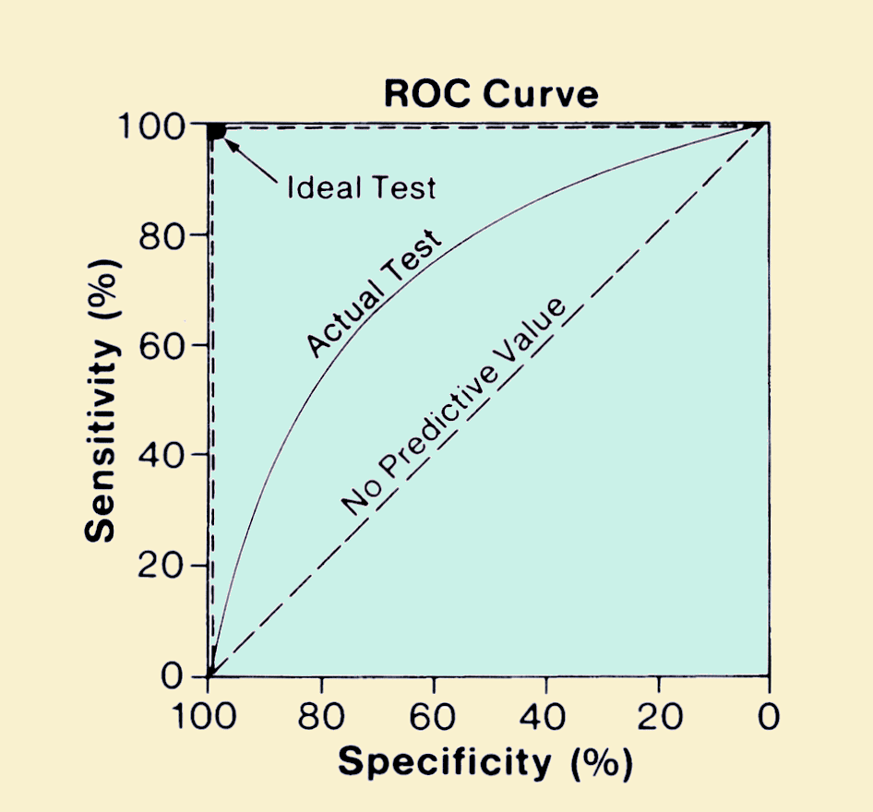
ROC Curve
ROC Is a probability curve and AUC represents degree or measure of separability.
Higher the AUC better the model is.
Here TPR is called the True Positive Rate aka Recall or Sensitivity and is given by TP / (TP+FN).
Specificity = TN / (TN + FP) and FPR (False Positive Rate) is 1 – Specificity.

Slide 61
Confusion Matrix
Y hat (Predicted Values)
Lets Say we are predicting the presence of disease which means yes – they have disease and no means – they don’t.
The classifier made total 165 predictions.
Out of those 165 cases, the classifier predicted "yes"
110 times, and "no" 55 times.
In reality, 105 patients in the sample have the disease, and 60 patients do not.
What is a Confusion Matrix
Y Actual Values
Lets understand the basic terms
True positives
True Negatives
False positives
False Negatives
Image Source: Google

Slide 62
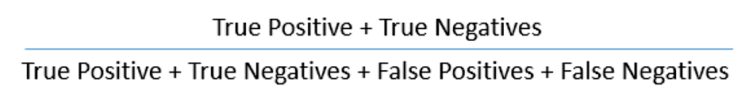
Performance of Logistic Regression Model
1. AIC (Akaike Information Criteria) – The analogous metric of adjusted R² in logistic regression is AIC. AIC is the measure of fit which penalizes model for the number of model coefficients. Therefore, we always prefer model with minimum AIC value.
2. Confusion Matrix : It is the tabular representation of Actual vs Predicted Values. It helps us find the accuracy of the model.
The accuracy is calculated using the following equation
3. ROC Curve:
The ROC Curve is known as Receiver Operating Characteristic Curve. It evaluates the trade off between true positive rate and false positive rate.
It is advisable to assume p>0.5 (threshold value) since, we are more concerned about the success of the model.
Higher the area under the curve, better the prediction power of the model would be.

Slide 63
Logistics Regression Assumptions
Logistics Regression does not need any linear relationship between the dependent and independent variables.
The error (residuals) need not be normally distributed.
There should be little to no multicollinearity amongst the independent variables.
The outcome is binary variable like yes or no, 1 or 0, positive or negative etc.
For a Binary Regression, the factor level 1 of the dependent variable should represent the desired outcome.
There is a linear relationship between the logit of the outcome and each predictor variables. Recall that the logit function is logit(p) = log(p/(1-p)), where p is the probabilities of the outcome.
Logistics Regression requires quite large sample sizes.

Slide 64
Forward & Backward Selection

Slide 65

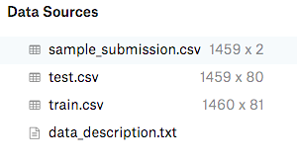
Forward Selection
Its a process which begins with empty model and keeps adding variables one by one.
Begins with Intercept. Tests are performed to find the relevant variables as ‘best’ variables.
The best variable shall return the highest coefficient of Determination or R-Squared Value.
This process keeps going and once the model no longer improves the accuracy by adding more variables, the process stops.
Several Criterions are used to determine which variable goes in – lowest RMSE on cross validation, F Test Score or lowest P Value.
Tip: While using Forward Selection, in order to test the accuracy of the model, its better to use the trained
Classifier against test data to make predictions.

Slide 66
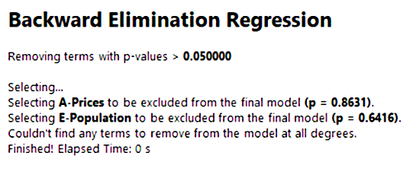
Backward Selection
Its a process which begins with all variables and keeps removing predictors one by one.
Removing the variable with the largest p-value | meaning the variable that is least significant.
The new (p-1) variable model is a better model where the largest p value is removed.
This process keeps going and once the model has significant p value defined, we may stop the process.
Several Criterions are used to determine which variable goes out – lowest RMSE on cross validation, F Test Score or lowest P Value

Slide 67

Let’s review some concepts
Linear Regression
Assumptions of Linear Regression
Difference Between Linear and Logistics Regression
Logistics Regression
Diagnostic Plots
Forward and Backward Elimination

Slide 68
Thanks!
Any questions?
You can find me at Linkedin
@mkschauhan
mukul.mschauhan@gmail.com
https://www.linkedin.com/pulse/data-visualisation-using-seaborn-mukul-kr-singh-chauhan
https://www.linkedin.com/pulse/introduction-ggplot-series-mukul-kr-singh-chauhan/
https://www.linkedin.com/pulse/what-data-science-mukul-chauhan/

